Slide 1

BRITISH AIRWAYS
CUSTOMER RATING ANALYSIS AND INSIGHTS

Slide 2
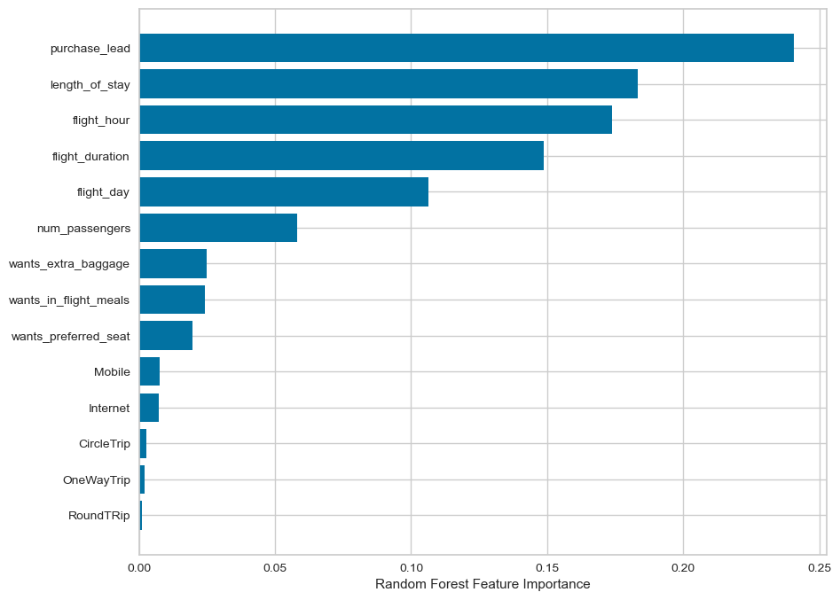
Predictive Modelling Results
Accuracy 63%
Precision 61%
Recall Rate 61%
Incomplete Bookings 42522
Complete Bookings 7478
Top features that can drive successful flight bookings.

